Slide 1
ETERNAL FOREST ENIGMA

Slide 2
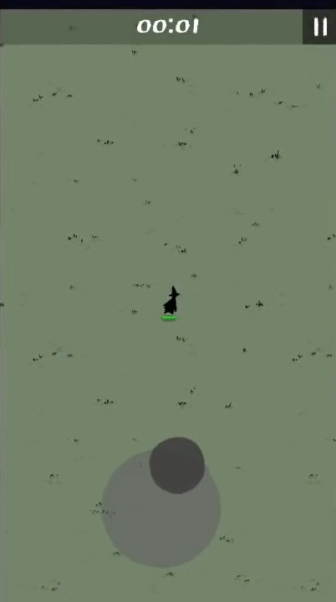
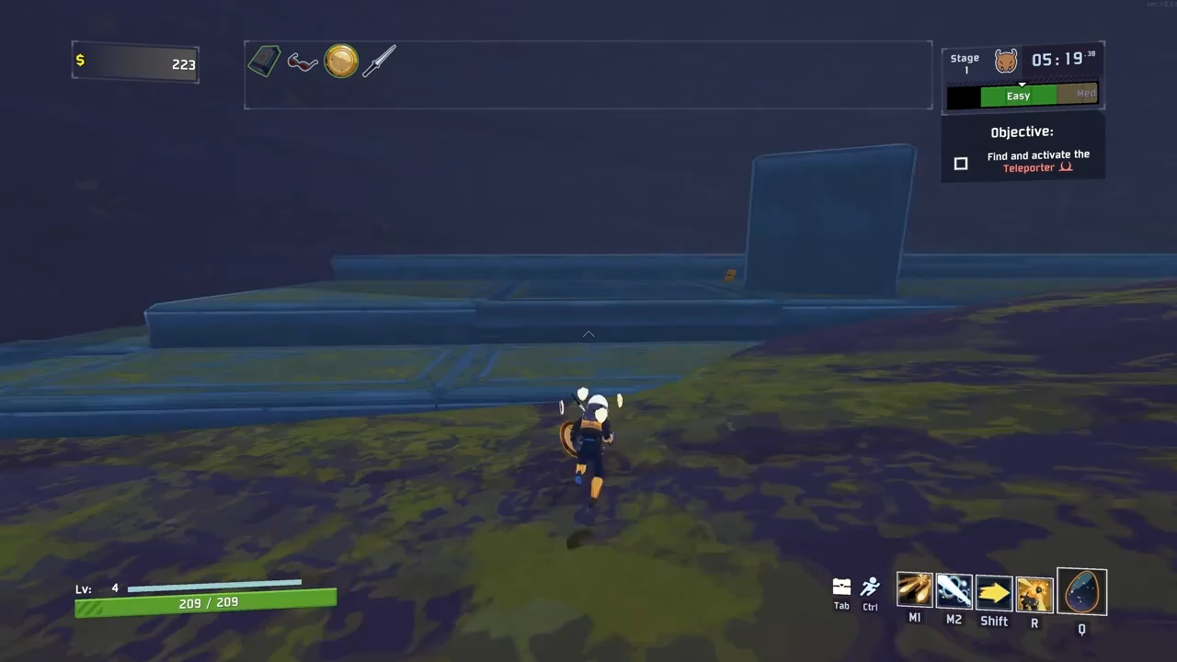
OVERVIEW:
It is a roguelike adventure game.
It is a single player shooting game.
It is based on “Magic Survival” and “Risk Of Rain”.
MAGIC SURVIVAL
A single player 2D shooting game for android.
RISK OF RAIN
A single player 3D shooting game for pc.

Slide 3
GAMEPLAY MECHANICS
This game is turn-based, that is the game only reacts when the player makes an action with the character. This allows player to evaluate a difficult situation, such as being cornered by several monsters, at their own pace and determine the best strategy.
This game works on the following flowchart :
POWER
FIRE RATE INCREASES
DAMAGE INCREASES
ENEMY SLOWS DOWN
POWER
SHOOT
ENEMY
POINT
POWER
SHOOT
BOSS
CHEST

Slide 4
STORY

Slide 5
PROJECT FUTURE AND OBJECTIVE
The main objective of the game is entertainment. It helps in reducing stress level. It is a shooting game. Playing shooting games can improve cognitive abilities, vision, and hand-eye coordination. Some studies have found that who play shooting games often perform better in decision-making, reaction time, spatial reasoning, spatial focus, visual ability and many other aspects.
We want to build this game at a scale such that we can publish and sell it on gaming platforms such as epic games and steam .

Slide 6
DEVELOPMENT TEAM
1. ARYAN GUPTA (Team Leader)
Game Artist
Game Programmer
2. ANKIT PATEL
Terrain
Player Design
3. GAURAV RAJESH
Game Levels
Animation and collectables
4. SHASHANK GUPTA
Sound Design
UI
MENTOR
AARTI RAI
3rd YEAR
CSE(AI&ML)

Slide 7



TECH STACK USED
THANK YOU!

